Slide 1

IBM Maximo Application Suite Scott Campbell ALM Proatauct Success Leader, campbesc@us.ibm.com Kim Woodbury Product Manager, Maximo kwoodbur@us.ibm.com Ahsan Umar Learning Content Development ahsanumar@ibm.com
Notes:
Welcome to the Maximo Application Suite (MAS) client presentation.
In this presentation, sellers learn about the challenges and market shifts affecting asset-intensive industries, IBM asset lifecycle management (ALM) strategy, and the various components of the Maximo Application Suite (MAS). The presentation also covers case studies that demonstrate the value of MAS. In addition to this client presentation, sellers can access the MAS level 1 seller enablement presentation at the following link: https://ibm.seismic.com/Link/Content/DC2CQHfJ46JRpGfCTf972JjMjH8G

Slide 2
Asset-intensive organizations face evolving business challenges
The costs of unplanned downtime are soaring.
Preventive maintenance and run-to-failure are still common.
There are pressing concerns on workforce productivity.
Decarbonization is a top driver for industrial digitization.
50% increase in hourly costs of downtime in just two years, from 2020 to 2022¹
56% of the market today either runs their assets to failure or practices traditional, time-based preventive maintenance²
35% or more service organizations cited that a lack of resources, workforce engagement, and retention are the most pressing concerns³
88% of industrial organizations see meeting decarbonization targets as the most significant drivers for digital transformation⁴
The True Cost of Downtime, Siemens, 2023
IDC SaaS Path, IDC, 2023
Service Leader’s Agenda, Service Council, 2024
Global Corporate Survey, Verdantix, 2023
Notes:
This slide highlights key industry insights that have shaped IBM asset lifecycle management (ALM) strategy, which is powered by Maximo Application Suite (MAS).
The first and primary observation is the challenge businesses face due to the rising cost of unplanned downtime. Through several client conversations, it became clear that these costs are tied to the growing criticality of assets in business operations. When a critical asset fails, the impact extends beyond just its maintenance costs, but it also results in a significant revenue loss. These costs are increasing year over year. Beyond cost, the frequency of these unplanned downtimes is also increasing, primarily because modern assets have become more complex, introducing more potential points of failure.
The second challenge also stems from increasing asset complexity. Maintenance strategies have not kept pace with advancements in today’s modern assets. Many organizations still rely on traditional approaches, such as "run-to-failure," where an action is taken only after an asset breaks, or on calendar-based maintenance, where maintenance is performed at set intervals regardless of the asset's actual condition.
The third challenge revolves around workforce productivity. Businesses are dealing with a growing skills gap that is caused by the exodus of highly skilled workers primarily due to retirement, which has not been offset by new technicians entering the field with the necessary expertise. This gap is further worsening as qualified workers frequently move between companies due to their high demand. Clients are actively seeking ways to close this gap and enhance productivity within their existing technician workforce.
Finally, decarbonization remains a key focus for businesses as organizations are striving to meet net-zero goals but often struggle with how to achieve them in practical terms.
These factors have become major drivers of change and innovation in asset lifecycle management.
References:
^{1 “}The True Cost of downtime”, Siemens, 03 April 2023. https://blog.siemens.com/2023/04/the-true-cost-of-downtime/
² “IDC SaaS path”, ID. https://www.idc.com/getdoc.jsp?containerId=IDC_P44535
³ “Service Leaders agenda”, Service Council, 2024. https://servicecouncil.com/reports/report-2024-service-leaders-agenda-summary-findings/
⁴ “Global Corporate Survey”, Verdantix, 2023. https://www.verdantix.com/report/global-corporate-survey-2023-esg-sustainability-budgets-priorities-and-tech-preferences

Slide 3

Factors driving the need for advanced asset management solutions
Data
Unprecedented levels of data are generated as OT/IT integration and connectivity accelerate.
AI
Advancements in AI enable further advanced analyses and productivity increases.
Convergence
Overlapping capabilities of asset management solutions and client needs for comprehensive solutions.
Sustainability
Environmental impact is added to the asset management conundrum of balancing asset performance, cost, and risk.
Notes:
In addition to the challenges discussed in the previous slide, a significant shift is also occurring across the broader market, which is driving the need for advanced asset management solutions. This slide explains some of the key drivers behind this shift.
One major factor is the sheer volume of data now accessible to clients. With the rise of the Internet of Things (IoT) sensor data and the corresponding asset informational technology (IT) data like work orders and maintenance logs, clients often share how they feel "data-rich but insights-poor," and struggle to filter through the overwhelming data noise to uncover actionable business insights.
The growing challenge of data overload is why AI has become a critical focus for organizations, as outlined in the second category on this slide. AI holds the promise of cutting through the noise to deliver instant, actionable insights from disparate and high-volume data sources. Generative AI, large language models, and foundation models are becoming integral to asset lifecycle management, helping businesses derive value from their data and improve decision-making processes.
The third area of focus is convergence. Over time, many organizations have built repositories comprising bespoke asset applications that are designed for specific functions, leading to data and process isolation. For instance, a business might use an enterprise asset management system primarily for maintenance, a separate performance management and monitoring system, a different reliability-centered maintenance program, and yet another system for asset investment and commissioning. These fragmented systems create inefficiencies, prompting clients to seek convergence into a unified asset system of record to streamline processes and eliminate silos.
Lastly, sustainability and decarbonization continue to be a major focus for clients. Clients are dealing with the challenge of balancing effective asset and operations management while simultaneously reducing net carbon emissions and achieving sustainability goals. Solving this conundrum is a complex but a pivotal task.
Terminology:
OT: Operational technology

Slide 4
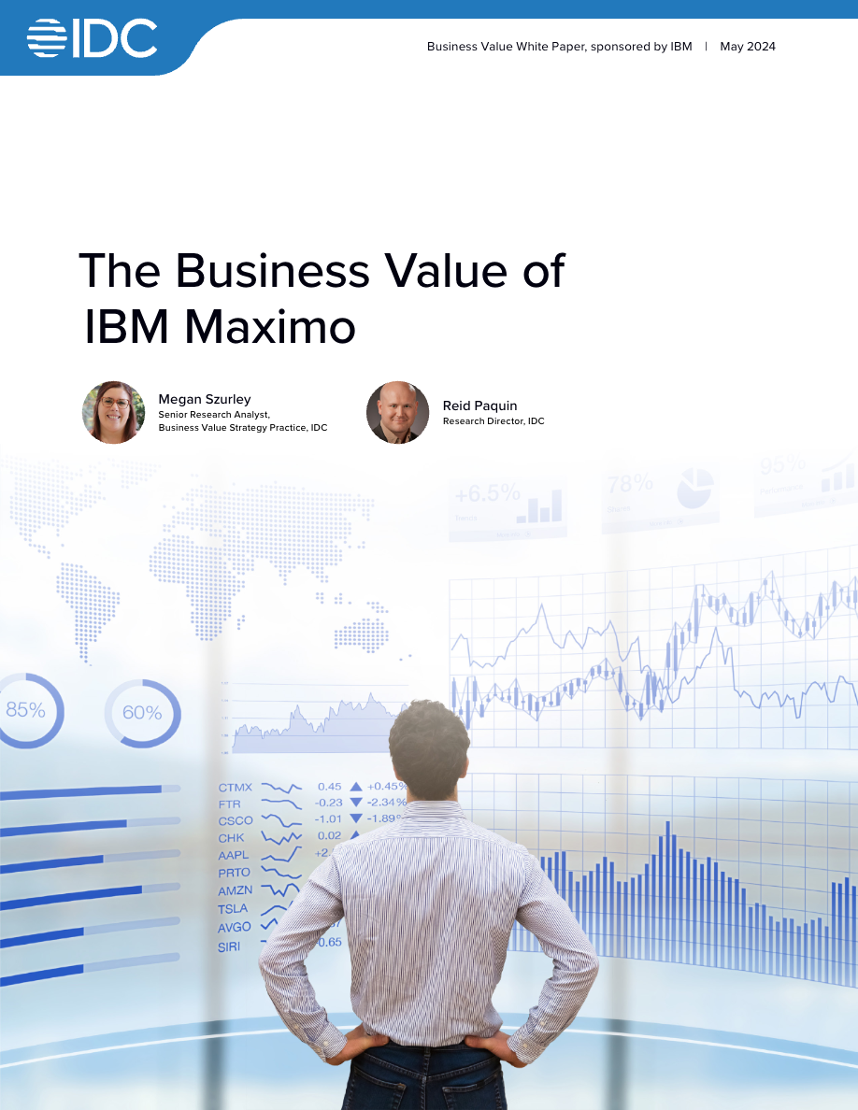
Maximo Application Suite is the cornerstone of asset lifecycle management, delivering value to IBM clients
Extend the lifespan of assets.
17% increase in asset lifespan*
Reduce maintenance and operations​ costs.
$243,000 annual asset management cost avoidance*
Manage risk associated with availability and sustainability.​
47% reduction in unplanned downtime*
Increase workforce productivity.
26% more productive technicians*
Download the IDC report
* Business value results are based on interviews with IBM Maximo® clients (number of clients interviewed = 10)
Notes:
Maximo Application Suite (MAS) is delivering tangible results to clients as they execute on the IBM asset lifecycle management (ALM) strategy.
International Data Corporation (IDC) was commissioned to gather client feedback on progress across key focus areas: extending asset lifespan, reducing maintenance and operational costs, managing risks associated with availability and sustainability, and increasing workforce productivity. The results of that survey are shown on this slide.
The first priority is extending asset lifespan while simultaneously reducing maintenance costs. It can be considered easier to extend an asset's life through constant maintenance, but doing so can significantly increase costs. The goal should be to achieve both objectives, that is, extending lifespan and reducing maintenance costs. IBM ALM helps achieves this by enabling condition-based and predictive maintenance capabilities. These capabilities allow clients to optimize maintenance schedules and resource allocation.
However, reducing maintenance costs and extending asset lifespan can introduce new risks, such as potential failures if assets are pushed beyond their intended limits or if maintenance is insufficient. But with the right capabilities provided by IBM, it becomes possible to mitigate these risks while achieving cost reductions and asset lifespan extensions.
With the addition of environmental data for climate-related risks and asset’s condition-based data for failure risks, clients can drive these four values at the same time. These values include extending the life of the asset, reducing the operational costs, reducing the risk of unplanned downtime, and operationalize sustainability goals.
Finally, a significant increase in workforce productivity is also reported by IBM ALM clients. This is about empowering technicians with the right information at the right time to get the work done correctly the first time.
Readers can access the full survey report by using the link that is provided in the reference section. It is expected that these numbers increase further as advancements continue into 2025 and 2026.
Reference:
^{1 “}The Business Value of IBM Maximo”, IDC, May 2024. https://www.ibm.com/downloads/documents/us-en/10a99803aaafd723

Slide 5
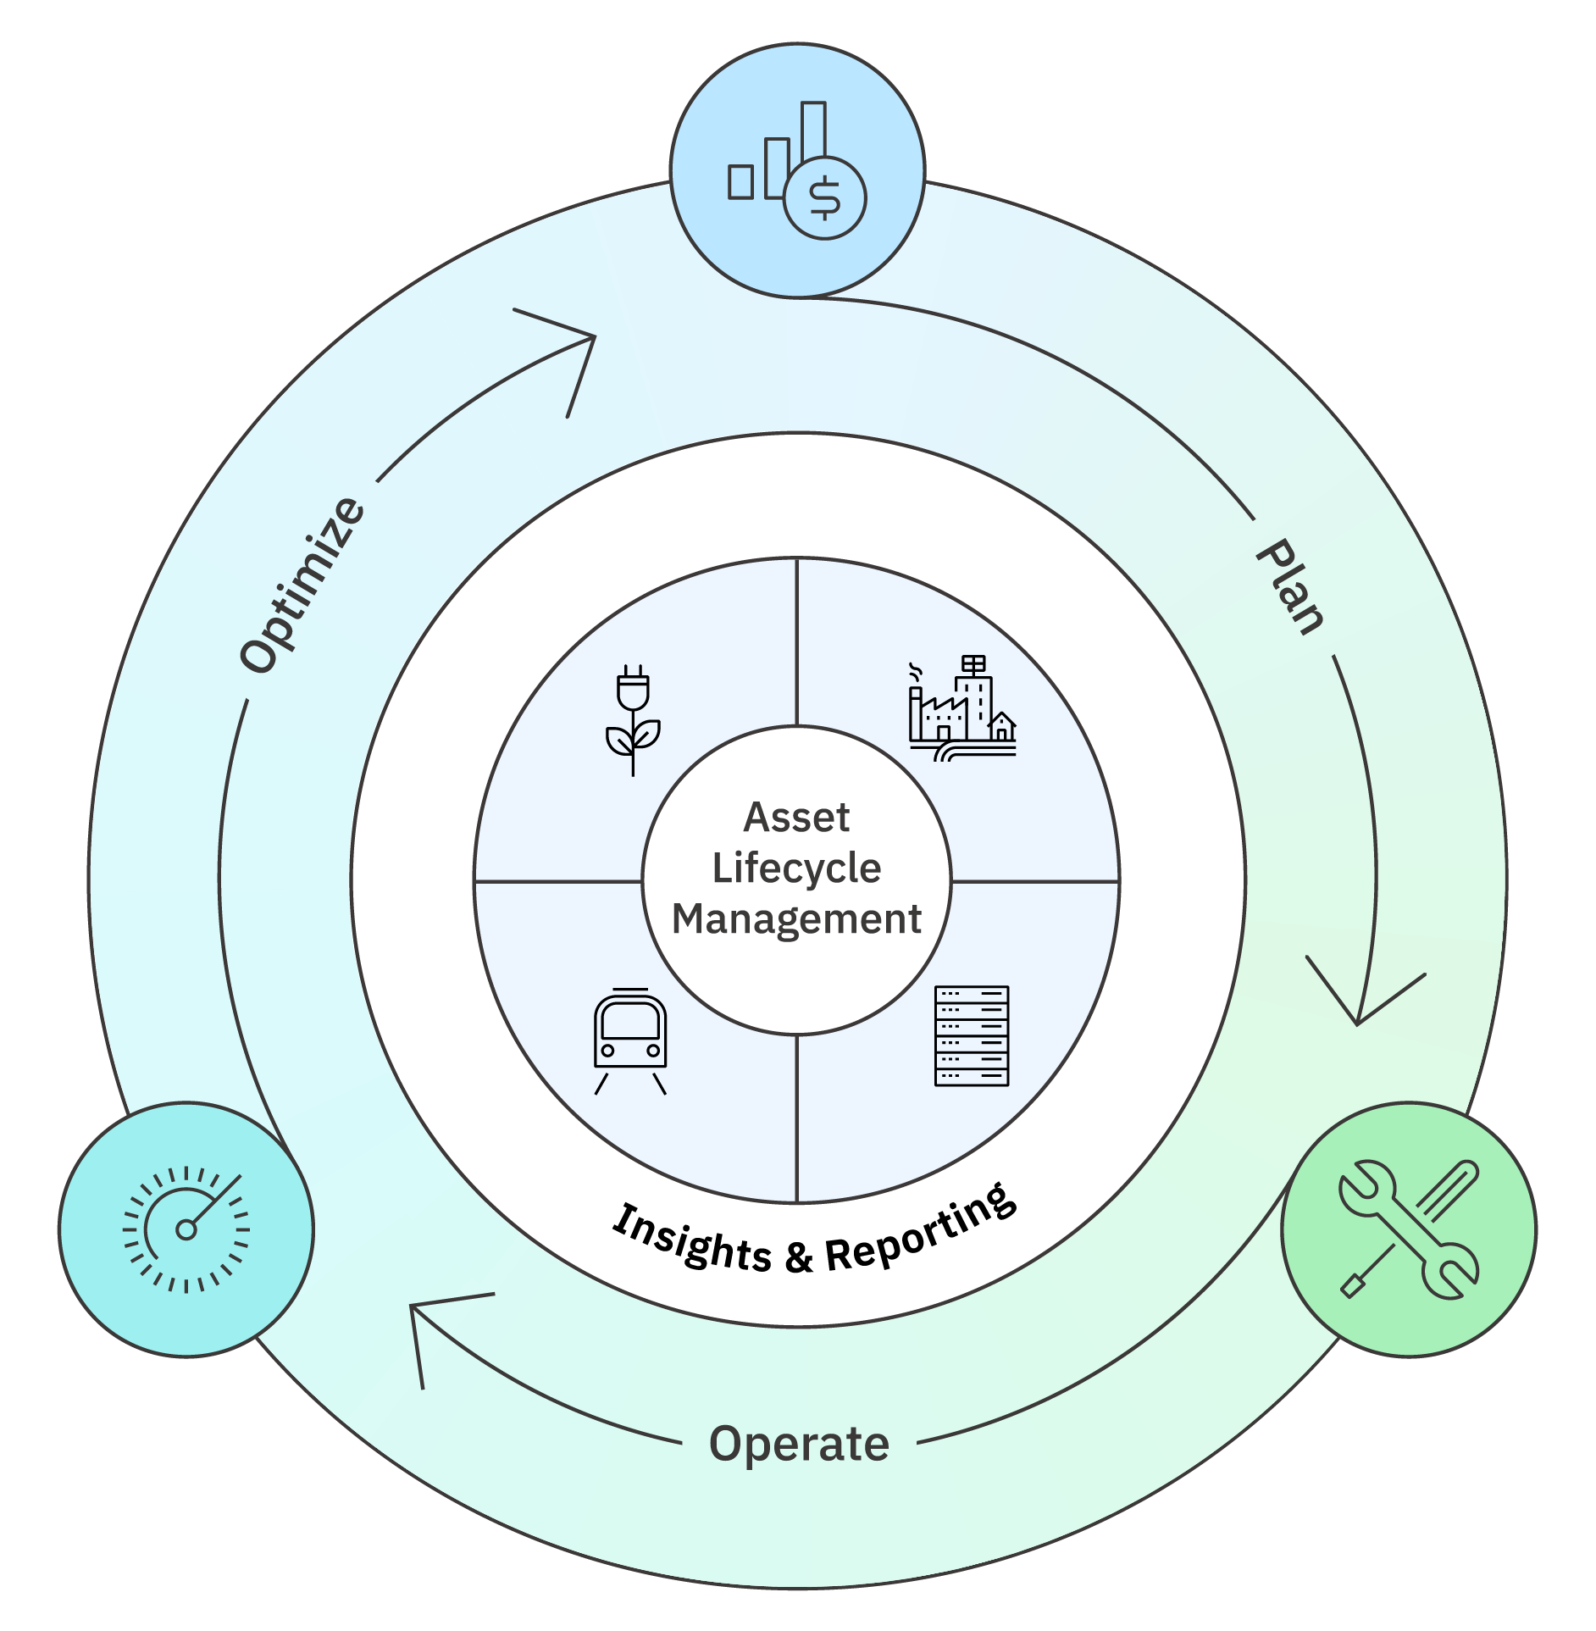
Vision: Optimize the whole lifecycle of assets with an integrated solution
It’s possible to improve workforce productivity and asset reliability while reducing operational cost, risk, and environmental impact.
Notes:
So, what is the IBM asset lifecycle management strategy?
IBM ALM strategy widens the lens through which organizations view assets. Instead of focusing solely on the operational perspective, IBM expands the scope to include the entire asset lifecycle, from planning and commissioning to operation, optimization, and, ultimately, decommissioning.
As outlined by this slide’s text, the objective of ALM is to enhance workforce productivity, extend asset life, and boost asset reliability, at the same time also reduce maintenance costs, mitigate failure risks, and help clients operationalize sustainability goals. Achieving all these objectives simultaneously is a complex challenge, but it can deliver immense value when executed successfully, a goal that the ALM strategy is designed to accomplish.
Another important capability within this strategy is insights and reporting, which brings actionable insights to the forefront. Whether through environmental, social, and governance (ESG) reporting, operational dashboards, or heat maps, these tools help clients prioritize tasks and make timely decisions.
IBM asset lifecycle management strategy is also tailored to industries, maintaining a consistent approach across various sectors while addressing the unique needs of specific asset classes. For instance, industries such as energy and utilities, manufacturing, travel, and transportation share commonalities in asset management practices but also have unique challenges. IBM has developed targeted solutions to meet those specific requirements, ensuring value and flexibility across diverse industries.

Slide 6
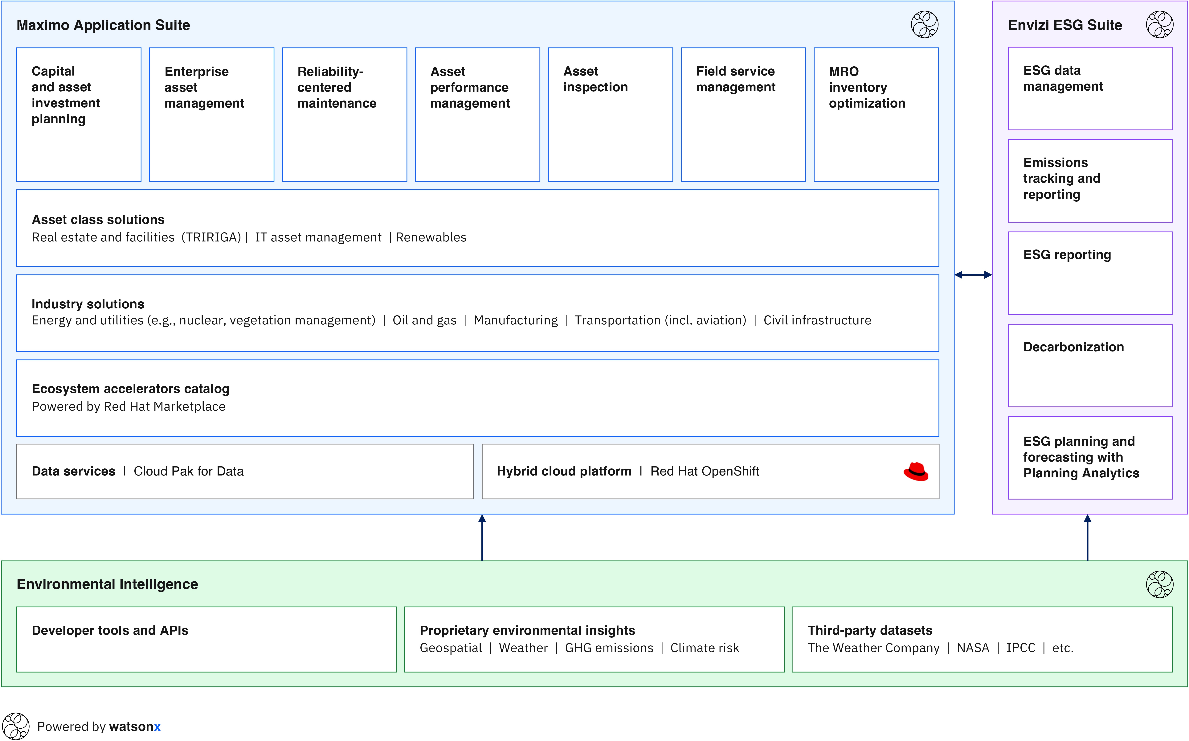
IBM asset lifecycle management powered by Maximo
IBM asset lifecycle management is an integrated solution powered by Maximo that optimizes the asset lifecycle performance for a wide-ranging industries and asset classes, leveraging AI, IoT, and environmental data.
Notes:
The implementation of the IBM asset lifecycle management (ALM) strategy is achieved through its ALM solution, which is built on the Maximo Application Suite (MAS) along with IBM Envizi and Environmental Intelligence Suite. This slide provides an overview of the building blocks that form this solution.
The IBM watsonx icon in the upper right corner of each of the component box highlights its infusion across the building blocks. Rather than simply offering watsonx for clients to explore on a trial-and-error basis, IBM identifies areas where it can deliver significant value. For example, within MAS, it powers work order intelligence, assists technicians, and supports reliability strategies such as failure mode and effects analysis (FMEA). Tasks that traditionally take a reliability engineer years can now be completed in weeks, revolutionizing the approach to asset management.
Here is a summary of the various capabilities that are offered within MAS portfolio (the blue box on this slide), which will keep expanding.
Capital and investment planning: It focuses on providing tools to help clients develop investment strategies and plan the commissioning of assets as they go live.
Enterprise asset management (EAM): Known as the heart of Maximo, this component includes work orders, maintenance strategies, and workforce productivity tools. It enables technicians to interact efficiently with assets, improving enterprise operational outcomes.
Reliability-centered maintenance (RCM): The third bucket is reliability centered maintenance, which is understanding an asset in terms of the failure modes and the effect analysis that is associated with those failures. This is how clients can start to bridge from their calendar-based maintenance into condition-based maintenance as they monitor the leading indicators for various asset failure modes. Clients can start to understand when a failure is likely to happen so that they can get in front of it, and this means now they are doing maintenance from the asset’s condition perspective instead of simply calendar-based maintenance. Understanding these failure modes, clients can perform maintenance work when they need to do it to avoid failure, and not over or under maintain an asset. Reliability-centered maintenance is the bridge to get from calendar-based maintenance to condition-based.
Asset performance management (APM): Closely tied to RCM, APM monitors asset’s sensor data to assess its health. Similarly, like monitoring human health indicators such as body temperature, blood pressure and sugar levels, thresholds and conditions are established for assets. When anomalies arise, clients receive alerts to take preventive action, ensuring optimal performance.
Asset inspection: This component uses computer vision in Maximo Visual Inspection (MVI) to automate inspections. AI analyzes data from drones, cameras, and other sources, reducing the need for manual inspection while enhancing accuracy and efficiency.
Field services management: This component provides the end-to-end capabilities to ensure that technicians have the right tools, skills, and information to complete tasks correctly the first time. It connects field technicians with back-office operations to optimize service delivery and maintenance operations.
Maintenance, repair, and operations Inventory optimization (MRO IO): This feature focuses on spare parts inventory management, ensuring availability while minimizing costs. Oftentimes, clients share with IBM sellers that they have millions of dollars that are tied up in spare parts inventory. As such, clients can use MRO IO to avoid excessive inventory or shortages and maintain optimal stock levels to support maintenance and repairs.
All these MAS components map to asset lifecycle management, targeting both, various asset classes and industries. For asset classes, examples include real estate, facilities, information technology (IT) asset management, renewables (wind turbines, solar energy, batteries), and data centers. For industry solutions, IBM tailors the strategy to meet the specific needs of each sector while still maintaining consistency.
MAS is built on Red Hat OpenShift (as indicated by the RedHat icon on the bottom right of the MAS box), supporting a cloud-native deployment model. It can be delivered as a software-as-a-service (SaaS) offering, on-premises, or as a hybrid model, providing flexibility to meet client’s preferences and requirements.
Terminology:
GHG: Greenhouse gases
NASA: National Aeronautics and Space Administration
IPCC: Intergovernmental Panel on Climate Change

Slide 7





Maximo Application Suite
Manage
Intelligent Asset Management
Real Estate & Facilities
Intelligent Asset Management
Best-of-class capabilities to provide a complete view of your assets addressing the needs of key personas in your organization.
Technicians
Technician Supervisor
Asset Maintenance Manager
Plant Manager
Fleet Manager
Finance Manager
Operations Manager
Reliability Engineer
Quality Manager
Planners/Schedulers
Dispatchers
Storeroom Managers
Purchasing Managers
Monitor
Monitor and Detect Anomalies
Health
360 View of Assets
Predict
Predictive Failures
Visual Inspection
AI-Powered Insights
Mobility and Dashboards | Intuitive and modernized
Operational Dashboards
Scheduling and Dispatching Dashboards
Service Requests
Asset audits
Work execution
Inspections
Inventory Count Books
Issues and transfers/receipts
Industry Solutions and Add-on’s | Accelerate time to value
Manage
Reliability Strategies
Manage
Location Service for Esri
Manage
Maximo IT
Manage
Health Safety and Environment
Manage
Scheduler Optimization
Manage
Service Provider
Agents and Alerts | AI and Analytical Insights
IBM Cloud Pak for Data | Watson | App Connect | Cognos Analytics
Infrastructure Independent
Common Operating Environment
IBM Cloud
AWS
Azure
Google Cloud
Private
Edge
Systems
Notes:
This slide provides a more detailed look into Maximo Application Suite (MAS).
MAS is a collection of applications that are designed and integrated to drive unique value for asset management, performance, and reliability. The capabilities that are offered by the suite address the needs of various roles within an organization from technicians, plant and operations managers, planners and more.
As stated, MAS is an integrated offering of multiple applications, each solving real business problems for asset intensive organizations. However, while it is an integrated solution, clients can still choose what applications they deploy and when.
Maximo Manage is a comprehensive enterprise asset management (EAM) application that uses advanced analytics and internet-of-things (IoT) data to help clients efficiently manage their infrastructure and assets. It offers tools to balance resources, materials, and services while optimizing work schedules. This ensures operational availability, improves supply chain efficiency, enhances safety and reliability for both assets and personnel, and supports compliance with regulatory requirements.
Real Estate and Facilities will be an addition to the suite in 2025 bringing the integrated workplace management system (IWMS) capabilities from TRIRIGA. This adds new modules to MAS, including Space Management and Reservation, Capital Planning, Facility Condition Assessment (FCA), and Lease Accounting.
Together, Maximo Monitor, Health and Predict, also known as Asset Performance Management, integrates AI into assets on the production floor. This powerful stack of applications enables clients to respond to alerts. It helps them make informed decisions about maintenance based on asset health scores. Clients can also predict potential asset failures with a high degree of accuracy. This allows them to address issues proactively, avoiding costly downtime.
Maximo Visual Inspection introduces visual AI models into quality inspection processes, empowering clients to "detect and correct" errors before they escalate into costly rework.
Maximo Mobile bridges the gap in technical expertise, enabling technicians to perform repairs more efficiently. It significantly improves first-time repair success rates by offering an intuitive toolset and on-demand collaboration features. With real-time access to information and expert support, technicians can diagnose issues faster and apply the right solutions on the first attempt.
MAS offers several add-ons, including Reliability Strategies, which provides a dedicated library of mitigation and preventive maintenance steps for thousands of asset classes. This ensures that best practice maintenance is performed, aligning with the asset's usage, environment, risk, and criticality. Users can also perform their own failure mode and effects analysis (FMEA) studies and expand on the existing library.
With Maximo IT (formerly known as IBM Control Desk) clients get to combine IT service management (ITSM) and IT asset management (ITAM) in one platform, a single point of user support and enterprise service management of information technology and operational technology (IT/OT) assets and processes. It combines physical asset management, help desk, and service desk functions in a cloud-based environment.
Health Safety and Environment provides a set of capabilities around incident tracking, remediation as well as advanced tracking of certifications and training for technicians.
MAS has a multi-cloud deployment support. This is driven by Red Hat OpenShift as the foundational technology that separates the management of the applications that form MAS from the management of the underlying infrastructure. This allows clients to focus on what’s important: taking a journey to zero downtime and zero defects (also knows as the journey to Zero D) and delivering business results. Because the suite is deployed on Red Hat OpenShift, it can be hosted on diverse public cloud providers, in a client’s private cloud, or on-premises.
Definitions:
ITAM: It is the end-to-end tracking and management of IT assets to ensure that every asset is properly used, maintained, upgraded, and disposed of at the end of its lifecycle. For further information, see https://www.ibm.com/blog/it-asset-management.
ITSM: It is the practice of providing the optimal deployment, operation, and management of every IT resource for every user across an enterprise. For further information, see https://www.ibm.com/topics/it-service-management

Slide 8
Asset maintenance practices and adoption of MAS
Reliability Strategies quickly enable to do the right maintenance, at the right time, for the right reason to drive the highest levels of asset and financial performance.
Financially
and reliably optimized
AI Prescriptive based
MAS delivers an integrated solution that enables coverage of all types of maintenance practices.
The asset maintenance practices and MAS adoption journey depend on factors including criticality of the asset, operating context, asset replacement cost, and its impact of failure on safety, environment, and operations.
Condition
based
Meter
based
Data-driven decisions (analytics)
Inspection
based
Time
based
Run-to-failure
Reactive
Adoption of Maximo Application Suite
Maintenance is an expense
Maintenance is an investment
RCM
EAM
APM
AIO / AIP
Notes:
Clients require various maintenance strategies to support different asset types based on priority, risk, and cost associated with each individual asset. Maximo Application Suite (MAS) delivers capabilities across Reliability Centered Maintenance (RCM), Enterprise Asset Management (EAM), Asset Performance Management (APM), and Asset Investment Planning and Optimization (AIP and AIO) as shown on the bottom of this slide.
At the lower-left section of the diagram, representing Reactive and Run-to-fail approaches, consider the example of light bulbs. While light bulbs may not be a typical asset in asset lifecycle discussions, it serves to illustrate the concept. In this scenario, the approach is reactive—client runs a light bulb until it fails, then replace it. Clients are not going to put sensors on it neither calculate health scores for it. They may ensure that the bulbs are functional in the critical areas, but they are likely not going to require rigorous analysis to achieve this.
When clients get to time-based maintenance, that is, they arrange scheduled inspections, repairs, or other maintenance activities at predetermined intervals based on a time schedule. In this approach, the timing of maintenance tasks is determined by specific dates. For example, checking those light bulbs weekly, monthly, or annually, rather than being triggered by the actual condition or usage of the asset. Calendar-based strategy still falls in the realm of Enterprise Asset Management (EAM) or Maximo Manage area, but when clients get to usage based and condition-based maintenance, then the condition or usage level of an asset is the deciding factor. This is where IBM Asset Performance Monitoring (APM) applications come in that allow to monitor the near real time condition of an asset by using AI to trigger any anomaly or failure alerts.
When clients get to the predictive strategy, they are getting into predictive maintenance, which is the realm of Maximo Predict application.
Clients can also implement a financially optimized strategy that is not necessarily the highest tier and can be applied in tandem with other strategies. MAS contains features to help create financially optimized options for asset planning and maintenance strategies.
Towards the right (of the diagram in this slide), the adoption of MAS increases as does the complexity of the maintenance strategy as shown across the bottom of the slide—RCM to AIO and AIP. However, this escalation also correlates with an increase in data-informed decision making.
Clients harnessing their data for more insightful decisions transition from a reactive to a predictive and financially optimized environment, where downtime is planned, and maintenance transforms from an expense into an investment.
It is important to recognize that one size does not fit all in asset management. Not every asset in an organization needs to be positioned in the far-right column of this diagram. Sometimes, a run-to-failure maintenance strategy is not only acceptable but also the most practical choice. The key is to decide intentionally, ensuring that the chosen strategy aligns with the asset's role and business impact. By applying the right approach to the right asset, organizations can optimize performance while maintaining efficiency.
MAS offers the full spectrum of asset maintenance strategies in helping clients to apply the right strategies to the right assets at the right time.

Slide 9

GenAI in Maximo
Integrated AI experiences that deliver immediate value and seamlessly scale with increased usage.
Work Order Intelligence
Work Order Intelligence, problem code recommendation. (available from MAS 9.0)
Improve maintenance decisions and data quality for reporting/analytics.
Expand to support other Maximo object attribute, like form fields using AI.
Maximo Assistant
Enhances Maximo productivity with a conversational AI assistant that provides on-demand insights and guided actions from unstructured data.
Utilizes data from Maximo Objects and augment by adding relevant documents to support various key roles and use cases.
FMEA Builder
Reduces creation time of asset FMEA from 100s of hours to minutes.
The FMEA data can provide AI Agents with knowledge about asset failure causes and mitigations.
Intelligent CBM
Automates workflows by integrating AI agents to generate work recommendations, smart alerts, and maintenance insights.
AI agents can autonomously make decisions, collaborate with other agents, and execute tasks based on the provided context and predefined objectives.
Notes:
This slide highlights the key areas where IBM is actively integrating or has already embedded generative AI within the Maximo Application Suite (MAS) experience.
Work Order Intelligence (WOI): Released in MAS 9.0 (2024), WOI enhances work order management by recommending problem codes during their creation, editing, and review. IBM identified that missing these codes can limit accurate insights and hinder future decision-making on maintenance effectiveness and predictive analytics. For instance, if a particular pump consistently fails due to the same issue but lacks proper problem code documentation, identifying recurring failures and predicting maintenance needs becomes challenging. WOI bridges this gap by offering intelligent recommendations ensuring more accurate data capture and improved maintenance strategies.
Maximo Assistant (planned for MAS 9.1): Maximo Assistant is a conversational AI tool that is designed to integrate with Maximo dashboards. It assists users by providing data insights, summaries, calculations, and quick data retrieval, streamlining workflows and decision-making.
Failure Mode and Effects Analysis (FMEA) Builder: Integrated within the Reliability Strategies library, this feature analyzes existing datasets to conduct failure mode and effects analysis efficiently. By using AI, it eliminates the need for extensive manual effort, saving potentially hundreds of hours.
Intelligent Condition-Based Maintenance (CBM): AI-driven CBM automates the creation of work recommendations, alerts, and insights based on maintenance and asset history by using multiple AI agents. This feature enhances predictive maintenance by proactively identifying necessary actions for future maintenance cycles.

Slide 10



IBM can help you increase time-to-value with solutions targeted at specific industries and asset classes
Industry
Energy and utilities
Industry
Travel and Transportation
Industry
Manufacturing
Monitor and analyze energy assets and improve the performance of energy portfolios.
Monitor and manage the wear and tear of airports, fleet, and rail to keep things moving safely, reliably, and sustainably.
Automate asset inspections and keep your assets running at peak performance.
Industry
Oil & Gas
Industry
Government
Industry
Natural Resources
Optimize processes in upstream and downstream with a focus on safety and compliance.
Ensure dependable service for civil infrastructure and port authorities.
Extend life of complex assets used in Mining and Agriculture.
Asset class
Facilities and real estate
Asset class
IT
Asset class
Renewables
Manage and optimize the operations and value of real estate portfolios, facilities, and assets.
Get a single point of user support and enterprise service management of IT/OT assets and processes.
Understand the asset performance of solar, wind, and energy storage for optimized results.
Notes:
This slide highlights key industries and asset classes that are supported by Maximo Application Suite (MAS). While the slide presents several asset classes and capabilities, MAS extends its functions to many others, making it a flexible solution across industries.
The largest segments of MAS users include:
Energy and utilities: Covering sectors such as water and wastewater management, transmission and distribution, and nuclear energy.
Travel and transportation: Supporting a wide range of fleets, including ferries, trucks, trains, and airplanes.
Manufacturing: Serving industries from automotive to food and beverage, as well as pharmaceuticals.
MAS provides robust asset management solutions across these and many other industries, helping organizations optimize operations and improve efficiency.
Terminology:
IT: Information technology
OT: Operational technology

Slide 11



Maximo: addressing challenges to drive ROI
Insight into how companies use Maximo Application Suite
Rail
A major US railroad saved USD 5 million by better tracking labor to specific work
A large passenger railroad was able to identify USD 18 million in excess or obsolete inventory
A railroad saved USD 1.8 million impacting areas such as financing, insurance, handling and overhead
A rail maintenance service company reduced costs 20 percent by optimizing material purchases
Fleet
A consumer products company with a medium size fleet increased warranty recovery 50 percent
A fleet management company saved USD 9.5 million by meeting 100 percent availability
Power
A power generation utility had 5 percent reduction in planned overhauls and eliminated 5 percent of forced outages saving USD 4.6 million annually
OEM: A large OEM reduced overhaul process time from 56 days to 21 days
Notes:
Maximo Application Suite (MAS) has driven real value for clients in terms of return on investments (ROI) as shown on this slide.
A major United States (US) railroad saved US dollars (USD) $5 million by better tracking labor to specific work.
A fleet management company saved USD $9.5 million by meeting 100% availability.
A power generation utility obtained a 5% reduction in planned overhauls and eliminated 5% of forced outages saving USD $4.6 million annually.
Terminology:
OEM: Original Equipment Manufacturer

Slide 12
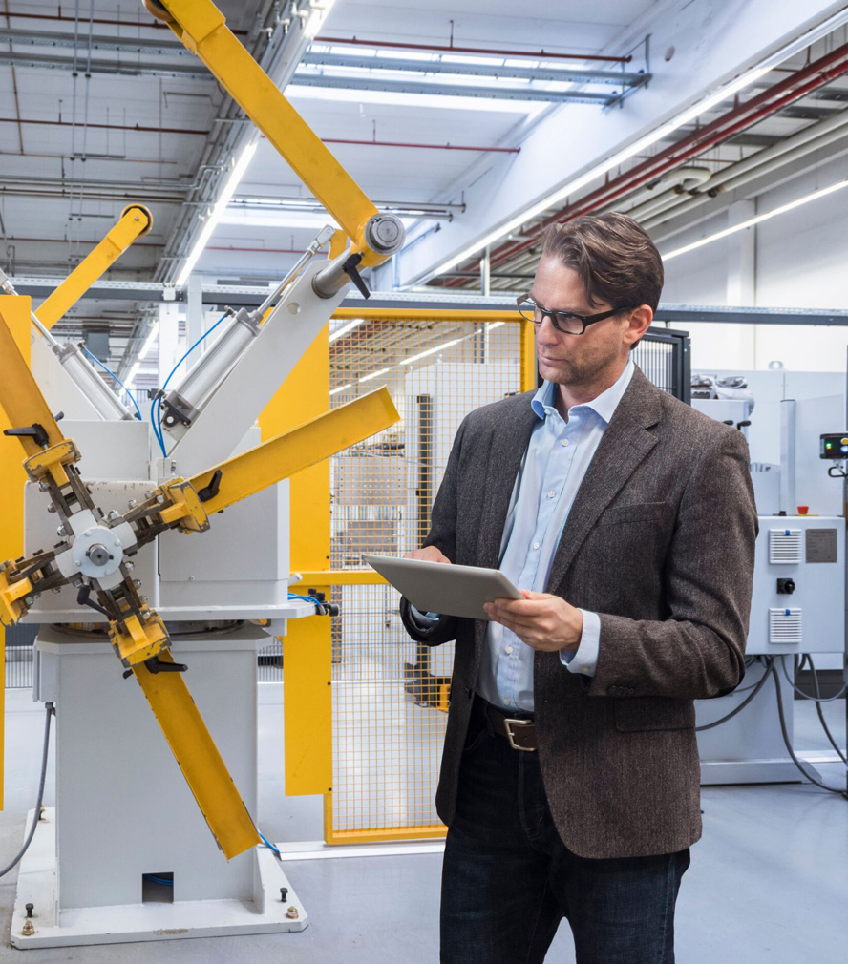
Why Maximo Application Suite?
IBM Maximo Application Suite can help you:
Maximize asset productivity
Improve service planning and scheduling
Improve capacity planning and forecasting
Support safety initiatives
Notes:
In summary, why Maximo Application Suite?
Maximize asset productivity: Improving asset visibility increases awareness of asset locations, conditions and commitments, and reduces unplanned asset downtime. The suite allows to detect and correct asset performance and quality issues before they become expensive rework.
Improve service planning and scheduling: Reduce the risk of business disruption and retaining and exploiting asset management records for general reporting, cost justification, and regulatory compliance.
Improve capacity planning and forecasting: By increasing efficiency, organizations can defer or even avoid unnecessary capital expenditures. The suite also eliminates the need for multiple standalone tools, cutting down on licensing and administrative costs. Additionally, it integrates physical asset management with broader business visibility, control, and automation, creating a more connected and streamlined approach.
Support safety initiatives: Collecting asset data helps to provide proactive and just-in-time analytics to help employers make decisions that improve workplace safety conditions and decrease disruption to the workplace.
With Maximo Application Suite, clients can gain these benefits and more in a single, integrated application that can be deployed in the cloud, on premises, or in a hybrid cloud approach.

Slide 13

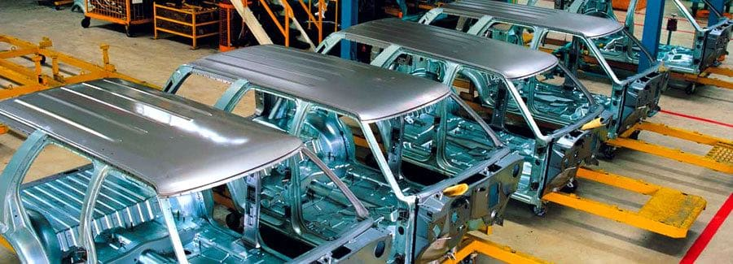





Moving forward
ROI analysis
Get started
Deploy at scale
Notes:
The best way for a client to start their journey to Maximo Application Suite (MAS) is to identify a specific problem or pain point and explore how MAS could address the issue. IBM can then jointly create a return-on-investment (ROI) analysis to determine the business value.
Assuming the ROI is sufficient, IBM can get started immediately, focusing on the specific problem to prove out the solution. Once there is proven success and business value, IBM works with the client to scale across the enterprise to address additional high-value areas.

Slide 14
Notes:
This slide is self-explanatory and does not require speaker notes.

Slide 15
Case studies
Notes:
This section covers client case studies.
In addition to the case studies presented in this section, sellers can choose Maximo Application Suite (MAS) client references relevant to their audience from the MAS Sales Kit link: https://ibm.seismic.com/Link/Content/DC3Pbd2BcT23dGhPXBJWqWVCB9Pj

Slide 16
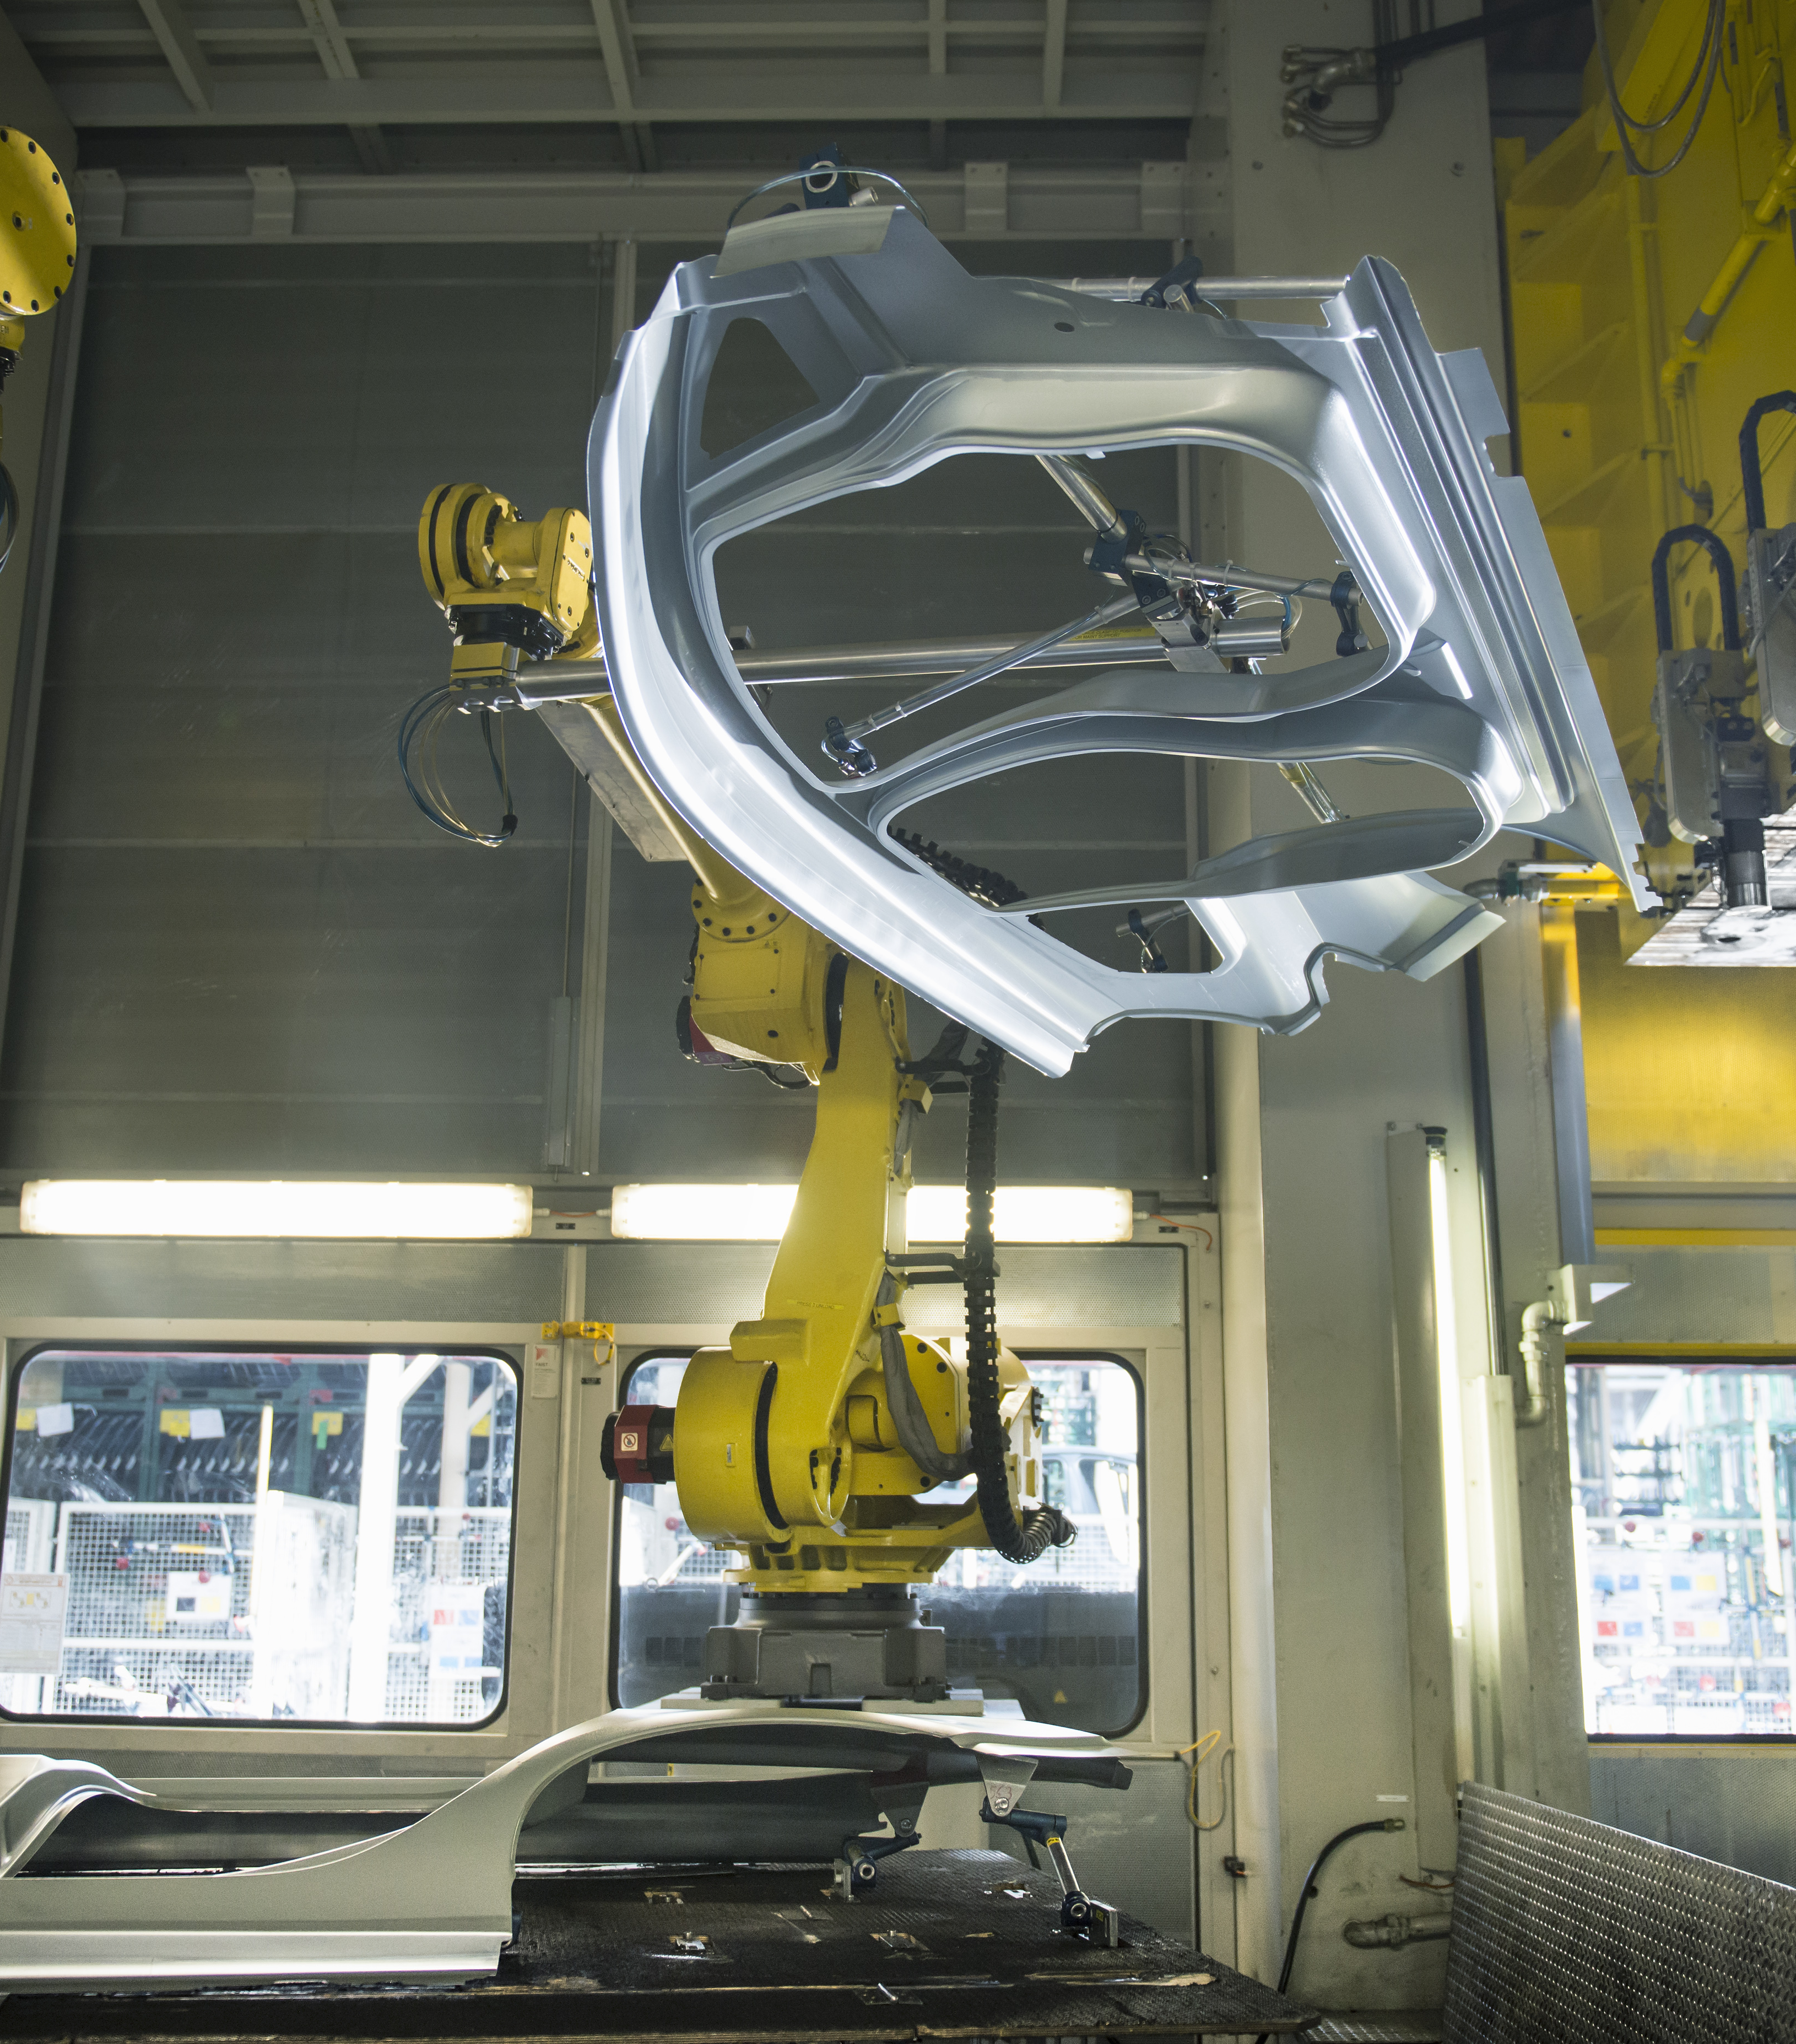
Case study
Large automobile company
Business problem:
Rework cost/time in manufacturing has a
serious impact on their business and production
Required consistency in inspecting defects to effectively produce new models of automotive
Results:
With Maximo Visual Inspection: Avoiding over 200 defects a day – ~ $1.8M a month savings
Ability to detect a defect at the point of installation
Notes:
Business problem:
This company had maintenance costs total over $1 Billion annually at 140 production sites globally. They required consistency in understanding critical asset health to effectively plan for capital improvement.
Solution:
Maximo Health was implemented providing real-time asset health monitoring with a score based on asset’s meter data, age, lifecycle costs, among others. They are also planning tools for active condition assessment, a data-driven approach to prioritizing asset replacement planning and seamless integration into Maximo Enterprise Asset Management.
Business value delivered:
Clients have gained deeper insights into asset criticality and replacement strategies, optimized preventive maintenance plans and vastly improved Mean Time Between Failures (MTBF). MTBF is the average time between system breakdowns. It is a crucial maintenance metric to measure performance, safety, and equipment design, especially for critical or complex assets, like generators or airplanes. It is also used to determine the reliability of an asset.
Sellers can choose Maximo Application Suite (MAS) client references relevant to their audience from the MAS Sales Kit link: https://ibm.seismic.com/Link/Content/DC3Pbd2BcT23dGhPXBJWqWVCB9Pj

Slide 17

Case study
Business problem:
The company did not have an effective capital assessment and planning process
Results:
Utilized data from smart sensors
Provided anomaly root-cause and process implications
Allowed for proactive intervention
Improved production reliability and reduced costly downtime
Regional water utility in North America
Notes:
Business problem:
This company’s inspection was predominantly manual with a custom application. Their assets were spread over counties in difficult to reach locations and they were only able to inspect assets every 3-5 years.
Solution:
They implemented Maximo Monitor. Current condition assessments are now in real-time using sensor data, augmented by Maximo inspections as needed providing more accurate assessments, improved replacement, and refurbishment planning decisions and eliminated the custom application that was costly to maintain.
Business value delivered:
Inspections are now frequent, accurate, and efficient. The company implemented an improved maintain/replace strategy and have eliminated the costly custom form-based applications.
Sellers can choose Maximo Application Suite (MAS) client references relevant to their audience from the MAS Sales Kit link: https://ibm.seismic.com/Link/Content/DC3Pbd2BcT23dGhPXBJWqWVCB9Pj

Slide 18

Case study
Oil and gas producers in Asia Pacific
Business problem:
Too much emergency maintenance and not staffed to handle the problems effectively
Results:
Utilized data from smart sensors
Provided anomaly root-cause and process implications
Allowed for proactive intervention
Improved production reliability and reduced costly downtime
Notes:
Business problem:
This company’s network extends over a vast geographic area – much of it in remote and even hostile environments. One of its biggest struggles was the high frequency of emergency maintenance, which was putting a strain on operations. The company also lacked the necessary staffing to manage maintenance issues efficiently. They also had substantial asset data, with minimal tools or expertise to analyze and make proper use of it.
Solution: Implementing Maximo Predict netted 87% predicted failure accuracy, with some models consistently providing 100% accurate results.
Business value delivered:
Avoided $10 million of missed revenue by proactively averting unplanned critical failures, increased production rates, and improved maintain or replace strategy.
Sellers can choose Maximo Application Suite (MAS) client references relevant to their audience from the MAS Sales Kit link: https://ibm.seismic.com/Link/Content/DC3Pbd2BcT23dGhPXBJWqWVCB9Pj

Slide 19
Thank you.
Notes:
This self-explanatory slide does not require speaker notes.

